Slide 1

Color Codes

Slide 2
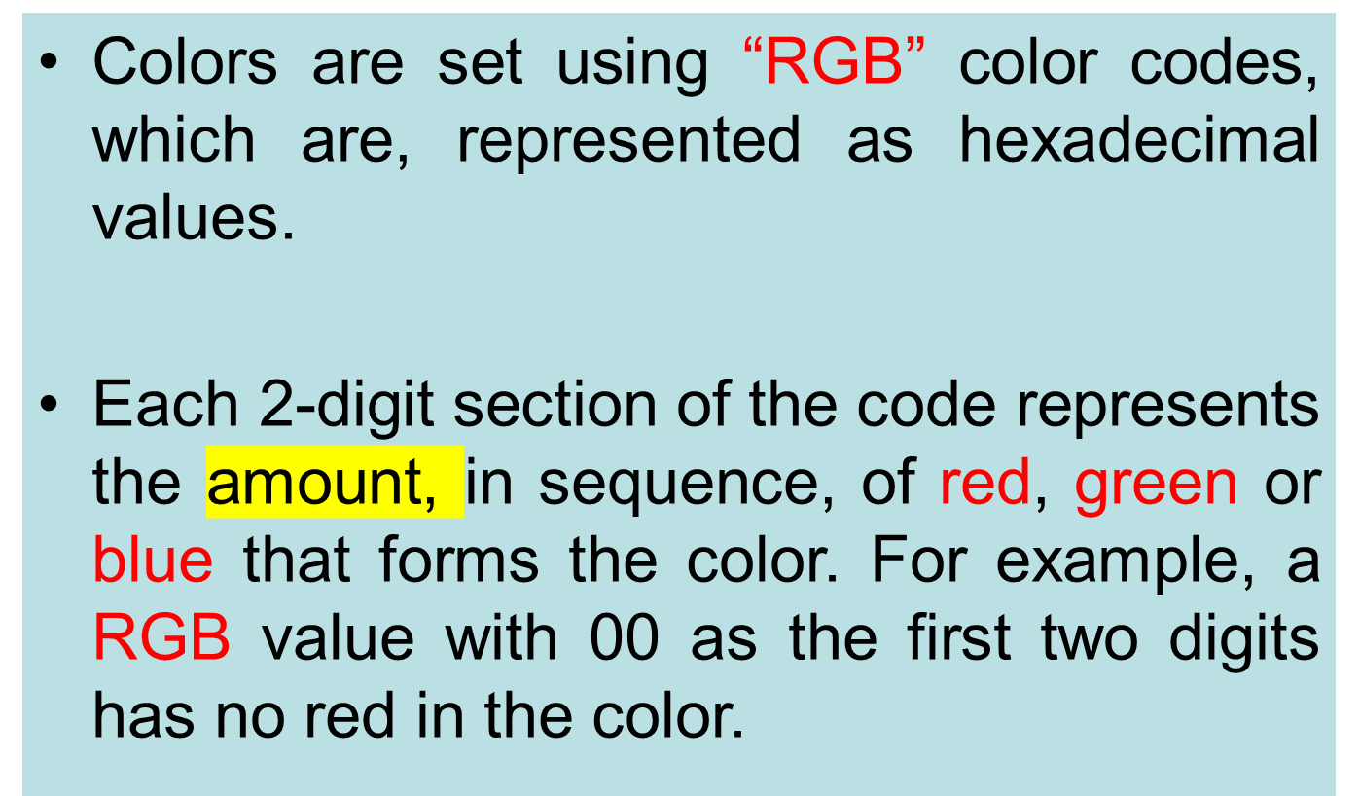
Color Codes

Slide 3
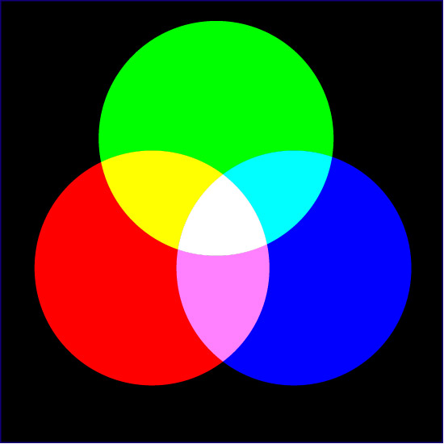

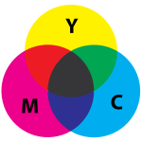
Main Colours

Slide 4
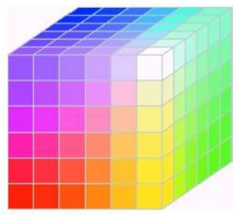
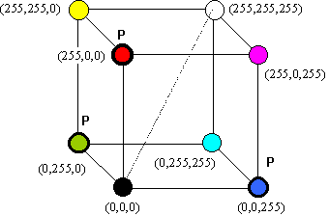
Main Colours
The total number of different colors that can be produced
(28)3= 256 x 256 x 256 = 16,777,216 colors

Slide 5
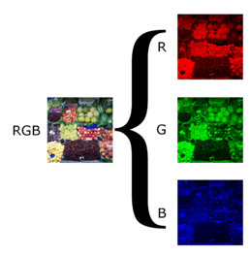
Main Colours

Slide 6
RGB
rgb(red, green, blue)
Each parameter (red, green, and blue) defines the intensity of the color with a value between 0 and 255.

Slide 7
RGB
For example, rgb(255, 0, 0) is displayed as red, because red is set to its highest value (255), and the other two (green and blue) are set to 0.
Another example, rgb(0, 255, 0) is displayed as green, because green is set to its highest value (255), and the other two (red and blue) are set to 0.
To display black, set all color parameters to 0, like this: rgb(0, 0, 0).
To display white, set all color parameters to 255, like this: rgb(255, 255, 255).

Slide 8

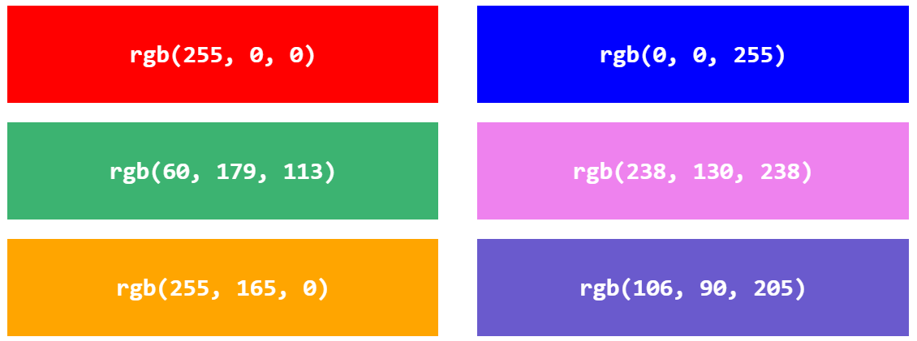
RGB

Slide 9
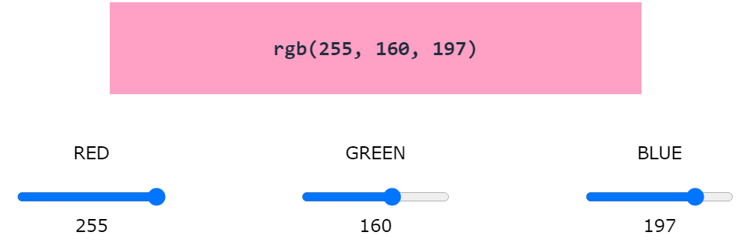
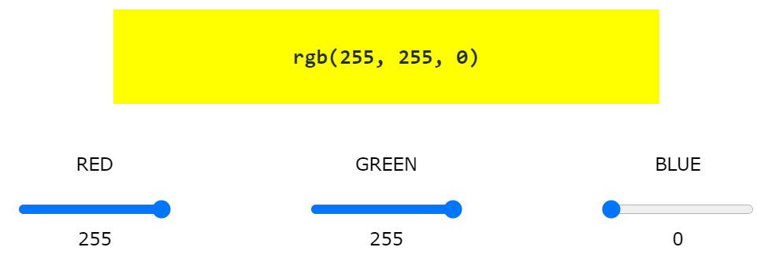
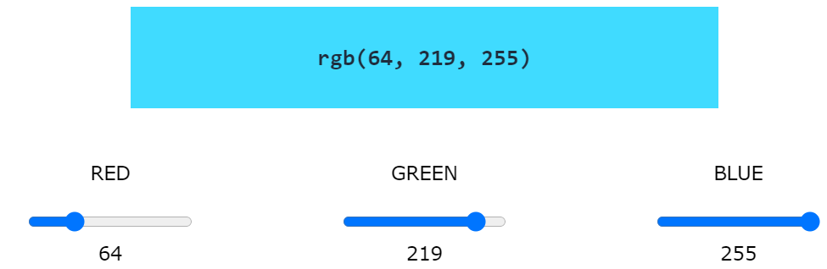

Slide 10
HEX - hexadecimal value
Where rr (red), gg (green) and bb (blue) are hexadecimal values between 00 and ff (same as decimal 0-255).
For example, #ff0000 is displayed as red, because red is set to its highest value (ff), and the other two (green and blue) are set to 00.
Another example, #00ff00 is displayed as green, because green is set to its highest value (ff), and the other two (red and blue) are set to 00.
To display black, set all color parameters to 00, like this: #000000.
To display white, set all color parameters to ff, like this: #ffffff.

Slide 11
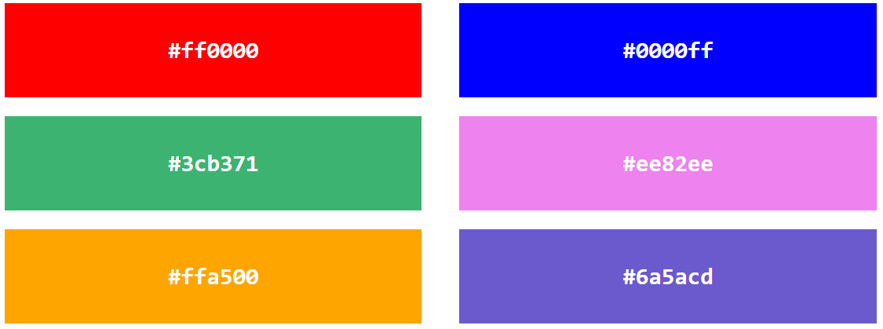
HEX

Slide 12
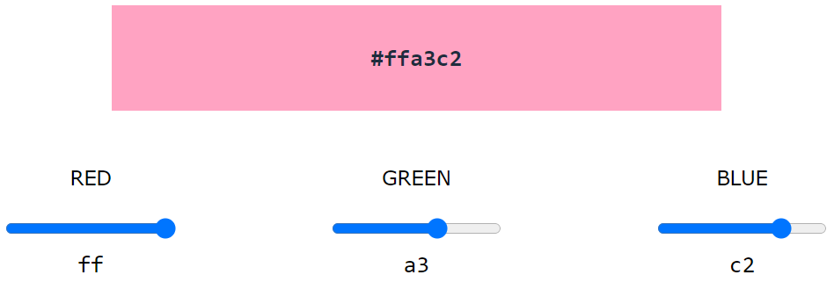
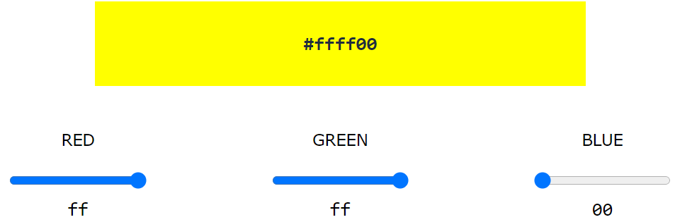
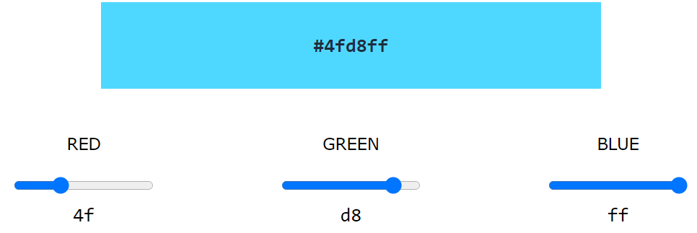

Slide 13
HSL
hsl(hue, saturation, lightness)
Hue is a degree on the color wheel from 0 to 360. 0 is red, 120 is green, and 240 is blue.
Saturation is a percentage value. 0% means a shade of gray, and 100% is the full color.
Lightness is also a percentage value. 0% is black, and 100% is white.

Slide 14
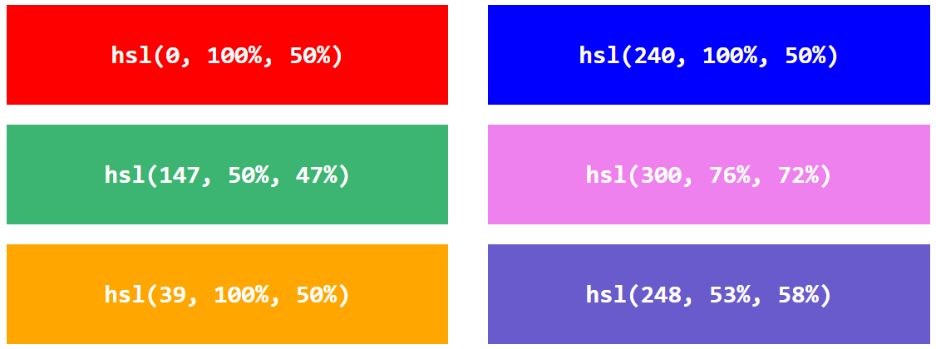
HSL

Slide 15
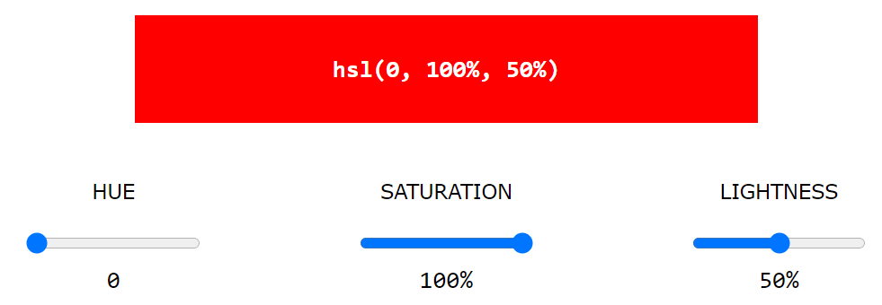
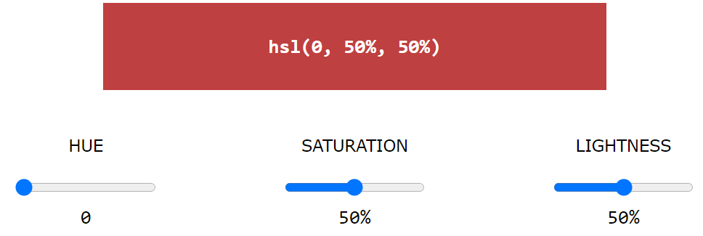
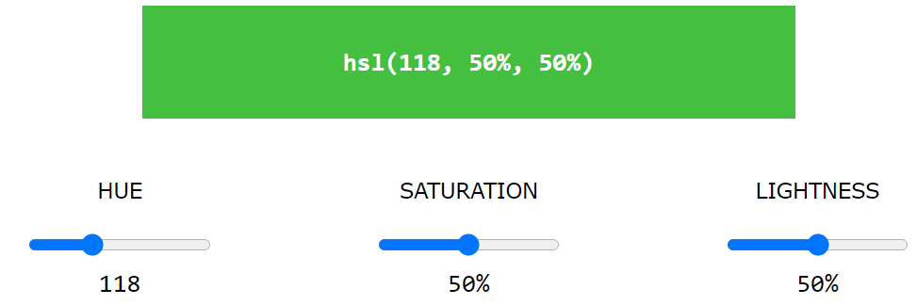

Slide 16
Color Codes
WHITE
BLACK
RED
GREEN
BLUE
MAGENTA
CYAN
YELLOW
AQUAMARINE
BAKER’S CHOCOLATE
VIOLET
BRASS
COPPER
PINK
ORANGE
#FFFFFF
#000000
#FF0000
#00FF00
#0000FF
#FF00FF
#00FFFF
#FFFF00
#70DB93
#5C3317
#9F5F9F
#B5A642
#B87333
#FF6EC7
#FF7F00

Slide 17
Color Codes
If you require more information about color values, there is an excellent site entitled “VGDesign’s Interactive Color Cube” that displays the background color code when you put your cursor over a small color sample. The Web address is :
http://www.vgdesign.com/color.html

Slide 18
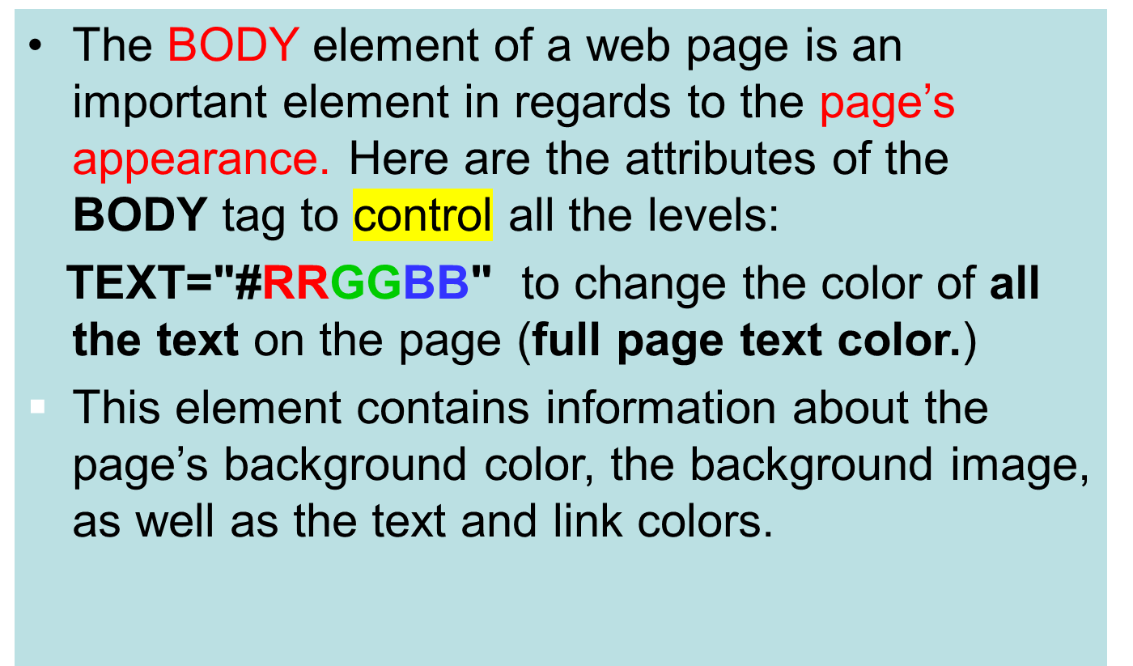
The Body Element

